Slide 1


Computer Security and Cryptography
Lecturer: Zhou Peng, Ph.D in Computer Network Security
pzhou@shu.edu.cn
Lecture 3

Slide 2
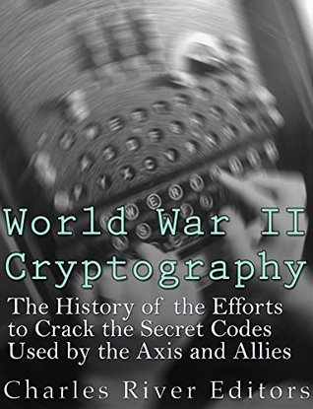
Computer Security and Cryptography
Lecture 3
Cryptography before World War II

Slide 3
This Lecture
Introduction to Cryptology
Terminology
Principles
Brief history of 4000 years of Cryptology
Cryptology before World War II
A simple substitution cipher
[Break]
Breaking substitution cipher
Vigenère Cipher
Cryptography before World War II

Slide 4
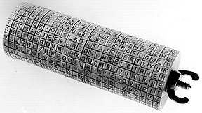
Jefferson Wheel Cipher
Cryptography before World War II

Slide 5
What is cryptology?
Greek: “krypto” = hide
Cryptology – science of hiding
Cryptography, Cryptanalysis – hide meaning of a message
Steganography, Steganalysis – hide existence of a message
Cryptography – secret writing
Cryptanalysis – analyzing (breaking) secrets
Cryptanalysis is what attacker does
Decipher or Decryption is what legitimate receiver does
Cryptography before World War II

Slide 6
Cryptology and Security
Cryptology is a branch of mathematics.
Security is about people.
Attackers try find the weakest link. In most cases, this is not the mathematics.
Cryptography before World War II

Slide 7
Introductions
Insecure Channel
Encrypt
Ciphertext
Decrypt
Plaintext
Plaintext
Eve
(passive attacker)
Alice
Bob
Cryptography before World War II

Slide 8
Introductions
Insecure Channel
Encrypt
Ciphertext
Decrypt
Plaintext
Plaintext
Alice
Malice
(active attacker)
Bob
Cryptography before World War II

Slide 9
Cryptosystem
Ciphertext = E(Plaintext)
Required property: E must be invertible
Plaintext = D(Ciphertext)
Desired properties:
Without knowing D must be “hard” to invert
E and D should be easy to compute
Possible to have lots of different E and D
Cryptography before World War II

Slide 10
“The enemy knows the system being used.”
Claude Shannon
Cryptography before World War II

Slide 11
Kerckhoff’s Principle
French handbook of military cryptography, 1883
Cryptography always involves:
Transformation
Secret
Security should depend only on the key
Don’t assume enemy won’t know algorithm
Can capture machines, find patents, etc.
Too expensive to invent new algorithm if it might have been compromised
Axis powers often forgot this
Cryptography before World War II

Slide 12
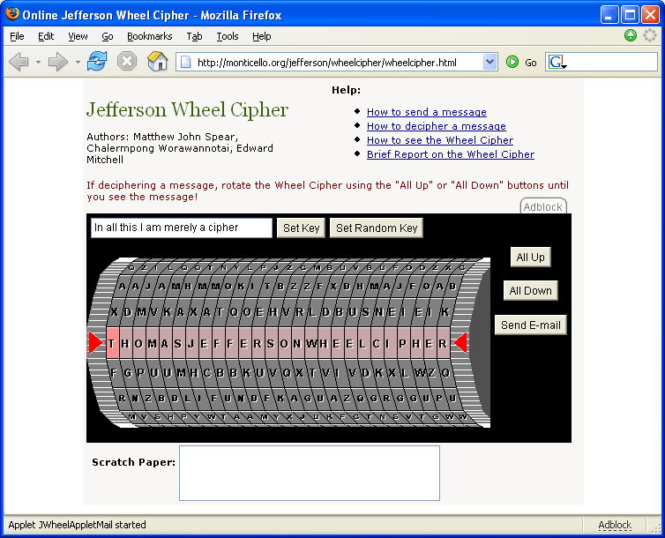
http://monticello.org/jefferson/wheelcipher/
Cryptography before World War II

Slide 13
Symmetric Cryptosystem
Ciphertext = E (K, Message)
Message = D (K, Ciphertext)
Desired properties:
Kerckhoff’s: secrecy depends only on K
Without knowing K must be “hard” to invert
Easy to compute E and D
All cryptosystems until 1970s were like this. Asymmetric cryptosystems allow encryption and decryption keys to be different.
Cryptography before World War II

Slide 14
Really Brief History First 4000 years
Vigenère
Babbage breaks Vigenère;
Kasiski (1863) publishes
Cryptographers
monoalphabetics
Alberti – first polyalphabetic cipher
Cryptanalysts
al-Kindi - frequency analysis
3000BC
900
1460
1854
Cryptography before World War II

Slide 15
Really Brief History - last 100+ years
Mauborgne – one-time pad
Quantum Crypto
?
Linear, Differential Cryptanalysis
Feistel block cipher, DES
Enigma adds rotors, stops repeated key
Turing’s loop attacks, Colossus
Public-Key
1978
Rejewski repeated message-key attack
Cryptanalysts
Mechanical ciphers - Enigma
Cryptographers
1854
1918
1939
1945
1973
1895 – Invention of Radio
Cryptography before World War II

Slide 16
Themes
Arms race: cryptographers vs. cryptanalysts
Often disconnect between two (e.g., Mary Queen of Scots uses monoalphabetic cipher long after known breakable)
Motivated by war (more recently: commerce)
Driven by advances in technology, mathematics
Linguists, classicists, mathematicians, computer scientists, physicists
Secrecy often means advances rediscovered and mis-credited
Cryptography before World War II

Slide 17
Types of Attacks
Ciphertext-only - How much Ciphertext?
Known Plaintext - often “Guessed Plaintext”
Chosen Plaintext (get ciphertext)
Not as uncommon as it sounds!
Chosen Ciphertext (get plaintext)
Dumpster Diving
Social Engineering
“Rubber-hose cryptanalysis”
Cryptanalyst uses threats, blackmail, torture, bribery to get the key
Cryptography before World War II

Slide 18
Security vs. Pragmatics
Trade-off between security and effort
Time to encrypt, cost and size of equipment, key sizes, change frequency
One-time pad (1918) offers theoretically “perfect” security, but unacceptable cost
Compromises lead to insecurity (class 2)
Commerce
Don’t spend $10M to protect $1M
Don’t protect $1B with encryption that can be broken for $1M
Military
Values (and attacker resources) much harder to measure
Cryptography before World War II

Slide 19
Simple Substitution Cipher
Substitute each letter based on mapping
Key is alphabet mapping:
a → J, b → L, c → B, d → R, ..., z → F
How secure is this cipher?
Cryptography before World War II

Slide 20
Key Space
Number of possible keys
26 (ways to choose what a maps to)
* 25 (b can map to anything else)
* 24 (c can map to anything else)
… * 1 (only one choice left for z)
= 26! = 403291461126605635584000000
If every person on earth tried one per second, it would take 5B years to try them all.
Cryptography before World War II

Slide 21
Really Secure?
Key space gives the upper bound
Worst possible approach for the cryptanalyst is to try all possible keys
Clever attacker may find better approach:
Eliminate lots of possible keys quickly
Find patters in ciphertext
Find way to test keys incrementally
Cryptography before World War II

Slide 22
Monoalphabetic Cipher
“XBW HGQW XS ACFPSUWG FWPGWXF CF AWWKZV CDQGJCDWA CD BHYJD DJXHGW; WUWD XBW ZWJFX PHGCSHF YCDA CF GSHFWA LV XBW KGSYCFW SI FBJGCDQ RDSOZWAQW OCXBBWZA IGSY SXBWGF.”
Cryptography before World War II

Slide 23
Frequency Analysis
“XBW HGQW XS ACFPSUWG FWPGWXF CF AWWKZV CDQGJCDWA CD BHYJD DJXHGW; WUWD XBW ZWJFX PHGCSHF YCDA CF GSHFWA LV XBW KGSYCFW SI FBJGCDQ RDSOZWAQW OCXBBWZA IGSY SXBWGF.”
W: 20 “Normal” English:
C: 11 e 12%
F: 11 t 9%
G: 11 a 8%
Cryptography before World War II

Slide 24
Pattern Analysis
“XBe HGQe XS ACFPSUeG FePGeXF CF AeeKZV CDQGJCDeA CD BHYJD DJXHGe; eUeD XBe ZeJFX PHGCSHF YCDA CF GSHFeA LV XBe KGSYCFe SI FBJGCDQ RDSOZeAQe OCXBBeZA IGSY SXBeGF.”
XBe = “the”
Most common trigrams in English:
the = 6.4%
and = 3.4%
Cryptography before World War II

Slide 25
Guessing
“the HGQe tS ACFPSUeG FePGetF CF AeeKZV CDQGJCDeA CD hHYJD DJtHGe; eUeD the ZeJFt PHGCSHF YCDA CF GSHFeA LV the KGSYCFe SI FhJGCDQ RDSOZeAQe OCthheZA IGSY StheGF.”
S = “o”
Cryptography before World War II

Slide 26
Guessing
“the HGQe to ACFPoUeG FePGetF CF AeeKZV CDQGJCDeA CD hHYJD DJtHGe; eUeD the ZeJFt PHGCoHF YCDA CF GoHFeA LV the KGoYCFe oI FhJGCDQ RDoOZeAQe OCthheZA IGoY otheGF.”
otheGF = “others”
Cryptography before World War II

Slide 27
Guessing
“the HrQe to ACsPoUer sePrets Cs AeeKZV CDQrJCDeA CD hHYJD DJtHre; eUeD the ZeJst PHrCoHs YCDA Cs roHseA LV the KroYCse oI shJrCDQ RDoOZeAQe OCthheZA IroY others.”
“sePrets” = “secrets”
Cryptography before World War II

Slide 28
Guessing
“the HrQe to ACscoUer secrets Cs AeeKZV CDQrJCDeA CD hHYJD DJtHre; eUeD the ZeJst cHrCoHs YCDA Cs roHseA LV the KroYCse oI shJrCDQ RDoOZeAQe OCthheZA IroY others.”
“ACscoUer” = “discover”
Cryptography before World War II

Slide 29
Guessing
“the HrQe to discover secrets is deeKZV iDQrJiDed iD hHYJD DJtHre; eveD the ZeJst cHrioHs YiDd is roHsed LV the KroYise oI shJriDQ RDoOZedQe OithheZd IroY others.”
Cryptography before World War II

Slide 30
Monoalphabetic Cipher
“The urge to discover secrets is deeply ingrained in human nature; even the least curious mind is roused by the promise of sharing knowledge withheld from others.”
- John Chadwick,
The Decipherment of Linear B
Cryptography before World War II

Slide 31
Why was it so easy?
Doesn’t hide statistical properties of plaintext
Doesn’t hide relationships in plaintext (EE cannot match dg)
English (and all natural languages) is very redundant: about 1.5 bits of information per letter (~68% f ltrs r redndnt)
Compress English with gzip – about 1:6
Cryptography before World War II

Slide 32
How to make it harder?
Cosmetic
Hide statistical properties:
Encrypt “e” with 12 different symbols, “t” with 9 different symbols, etc.
Add nulls, remove spaces
Polyalphbetic cipher
Use different substitutions
Transposition
Scramble order of letters
Cryptography before World War II

Slide 33
Ways to Convince
“I tried really hard to break my cipher, but couldn’t. I’m a genius, so I’m sure no one else can break it either.”
“Lots of really smart people tried to break it, and couldn’t.”
Mathematical arguments – key size (dangerous!), statistical properties of ciphertext, depends on some provably (or believed) hard problem
Invulnerability to known cryptanalysis techniques (but what about undiscovered techniques?)
Cryptography before World War II

Slide 34
Vigenère
Invented by Blaise de Vigenère, ~1550
Considered unbreakable for 300 years
Broken by Charles Babbage but kept secret to help British in Crimean War
Attack discovered independently by Friedrich Kasiski, 1863.
Cryptography before World War II

Slide 35
Vigenère Encryption
Key is a N-letter string.
E_{K} (P) = C where
C_{i} = (P_{i} + K_{i mod N}) mod Z
(size of alphabet)
E_{“KEY”} (“test”) = DIQD
C₀ = (‘t’ + ‘K’) mod 26 = ‘D’
C₁ = (‘e’ + ‘E’) mod 26 = ‘I’
C₂ = (‘s’ + ‘Y’) mod 26 = ‘Q’
C₃ = (‘t’ + ‘K’) mod 26 = ‘D’
Cryptography before World War II

Slide 36
12345678901234567890123456789012345678901234567890123456
Plain: ThebiggerboysmadeciphersbutifIgotholdofafewwordsIusually
Key: KEYKEYKEYKEYKEYKEYKEYKEYKEYKEYKEYKEYKEYKEYKEYKEYKEYKEYKE
Cipher: DLCLMEQIPLSWCQYNIASTFOVQLYRSJGQSRRSJNSDKJCGAMBHQSYQEEJVC
7890123456789012345678901234567890123456789012345678901234
Plain: foundoutthekeyTheconsequenceofthisingenuitywasoccasionally
Key: YKEYKEYKEYKEYKEYKEYKEYKEYKEYKEYKEYKEYKEYKEYKEYKEYKEYKEYKEY
Cipher: DYYLNSSDXFOOCIXFOGMXWCAYCXGCYJRRMQSREORSSXWGEQYGAKWGYRYVPW
5678901234567890123456789012345678901234567890123456789
Plain: painfultheownersofthedetectedcipherssometimesthrashedme
Key: KEYKEYKEYKEYKEYKEYKEYKEYKEYKEYKEYKEYKEYKEYKEYKEYKEYKEYK
Cipher: ZEGXJSVXFOSUXIPCSDDLCNIROGROHASTFOVQCSKOXGWIQDLPKWFOHKO
012345678901234567890123456789012345
Plain: thoughthefaultlayintheirownstupidity
Key: YKEYKEYKEYKEYKEYKEYKEYKEYKEYKEYKEYKE
Cipher: XFYYERXFOJYEPRVEWSRRRIGBSUXWRETGNMRI
Charles Babbage (quoted in Simon Singh, The Code Book)
Cryptography before World War II

Slide 37
Babbage’s Attack
Use repetition to guess key length:
Sequence XFO appears at 65, 71, 122, 176.
Spacings = (71 – 65) = 6 = 3 * 2
(122 – 65) = 57 = 3 * 19
(176 – 122) = 54 = 3 * 18
Key is probably 3 letters long.
Cryptography before World War II

Slide 38
Key length - Frequency
Once you know key length, can slice ciphertext and use frequencies:
L₀: DLQLCNSOLSQRNKGBSEVYNDOIOXAXYRSOSGYKY
VZXVOXCDNOOSOCOWDKOOYROEVSRBXENI
Frequencies: O: 12, S: 7, Guess O = e
C_{i} = (P_{i} + K_{i mod N}) mod Z
‘O’ = (‘e’ + K₀) mod 26
14 = 5 + 9 => K₀ = ‘K’
Cryptography before World War II

Slide 39
Sometimes, not so lucky...
L₁: LMISQITVYJSSSJAHYECYSXOXGWYGJMRRXEGWRPEJXSI
SLIGHTVSXILWHXYXJPERISWTM
S: 9, X: 7; I: 6 guess S = ‘e’
‘S’ = (‘e’ + K₁) mod 26
19 = 5 + 14 => K₁ = ‘N’
‘X’ = (‘e’ + K₁) mod 26
24 = 5 + 19 => K₁ = ‘M’
‘I’ = (‘e’ + K₁) mod 26
10 = 5 + 5 => K₁ = ‘E’
Cryptography before World War II

Slide 40
Vigenère Simplification
Use binary alphabet {0, 1}:
C_{i} = (P_{i} + K_{i mod N}) mod 2
C_{i} = P_{i} ⊕ K_{i mod N}
Use a key as long as P:
C_{i} = P_{i} ⊕ K_{i}
One-time pad – perfect cipher!
Cryptography before World War II

Slide 41
Perfectly Secure Cipher: One-Time Pad
Mauborgne/Vernam [1917]
XOR (⊕):
0 ⊕ 0 = 0 1 ⊕ 0 = 1
0 ⊕ 1 = 1 1 ⊕ 1 = 0
a ⊕ a = 0
a ⊕ 0 = a
a ⊕ b ⊕ b = a
E(P, K) = P ⊕ K
D(C, K) = C ⊕ K = (P ⊕ K) ⊕ K = P
Cryptography before World War II

Slide 42
Why perfectly secure?
For any given ciphertext, all plaintexts are equally possible.
Ciphertext: 01001
Key1: 01001
Plaintext1: 00000
Key2: 10110
Plaintext2: 11111
Cryptography before World War II

Slide 43
Perfect Security Solved?
Cannot reuse K
What if receiver has
C₁ = P₁ ⊕ K and C₂ = P₂ ⊕ K
C₁ ⊕ C₂ = P₁ ⊕ K ⊕ P₂ ⊕ K
= P₁ ⊕ P₂
Need to generate truly random bit sequence as long as all messages
Need to securely distribute key
Cryptography before World War II

Slide 44
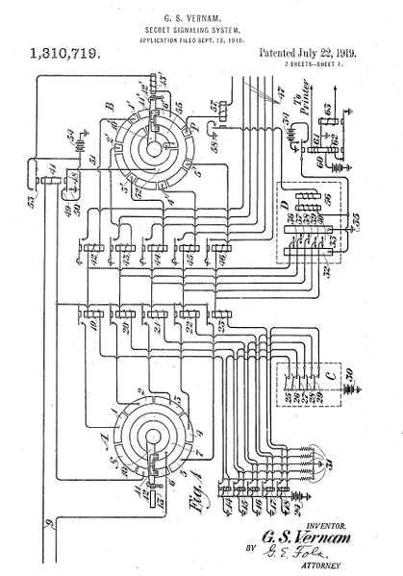
One-Time Pad
Vernam [1917]
(AT&T Bell Labs)
Key Letters
Relays combine key and plaintext letters
Plaintext Letters
The Lorenz Cipher and the Postman’s Computer

Slide 45
The Baudot Code (like Morse Code, not a cipher)
A | 00011 | H | 10100 |  |  | space | 00100
B | 11001 | I | 00110 | ... | ... | return | 01000
C | 01110 | J | 01011 | V | 11110 | line feed | 00010
D | 01001 | K | 01111 | W | 10011 | letter shift | 11111
E | 00001 | L | 10010 | X | 11101 | figure shift | 11011
F | 01101 | M | 11100 | Y | 10101 | error | 00000
G | 11010 | N | 01100 | Z | 10001
Encode 32 letters using 5 on/off signals
The Lorenz Cipher and the Postman’s Computer

Slide 46
Why perfectly secure?
For any given ciphertext, all plaintexts are equally possible.
Ciphertext: J = 01001
Key1: I = 00110
Plaintext1: 01111 = K
Key2: L = 10010
Plaintext2: = 11011 = shift
The Lorenz Cipher and the Postman’s Computer

Slide 47
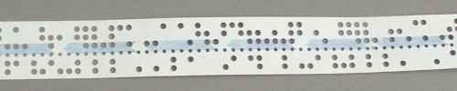
Vernam’s Key
A long paper tape with random letters on it (using Baudot code)
Cannot reuse key – tape must be very long!
This has 6 holes per letter
(not Baudot code)
The Lorenz Cipher and the Postman’s Computer

Slide 48
Morehouse’s Improvement
Like Vernam machine, but with two key tapes
Tape 1
(999 letters)
Tape 2
(1000 letters)
The Lorenz Cipher and the Postman’s Computer

Slide 49
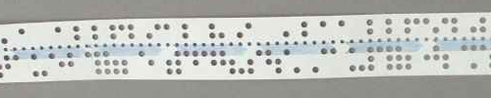
Morehouse’s Improvement (patented in 1920)
Message
⊕
Tape 1
(999 letters)
⊕
Tape 2
(1000 letters)
=
Ciphertext
The Lorenz Cipher and the Postman’s Computer

Slide 50
Looping Tapes
Tape 1
(999 letters)
Tape 2
(1000 letters)
The tape equivalent to Tape 1 ⊕ Tape 2 would not repeat for 999 * 1000 letters!
Note: it is no longer a perfect cipher though. Some keys are not possible after 1001 letters.
The Lorenz Cipher and the Postman’s Computer

Slide 51
Lorenz Cipher
Based on the Vernam and Morehouse
Used Baudot code
Believed managing long paper tapes during wartime was too difficult
Machine generates key sequence
If two machines start in same configuration, same key sequence
Will not repeat for ~ 10¹⁹ letters
All words ever spoken or written by all humans is estimated around 10¹⁸ letters
The Lorenz Cipher and the Postman’s Computer

Slide 52
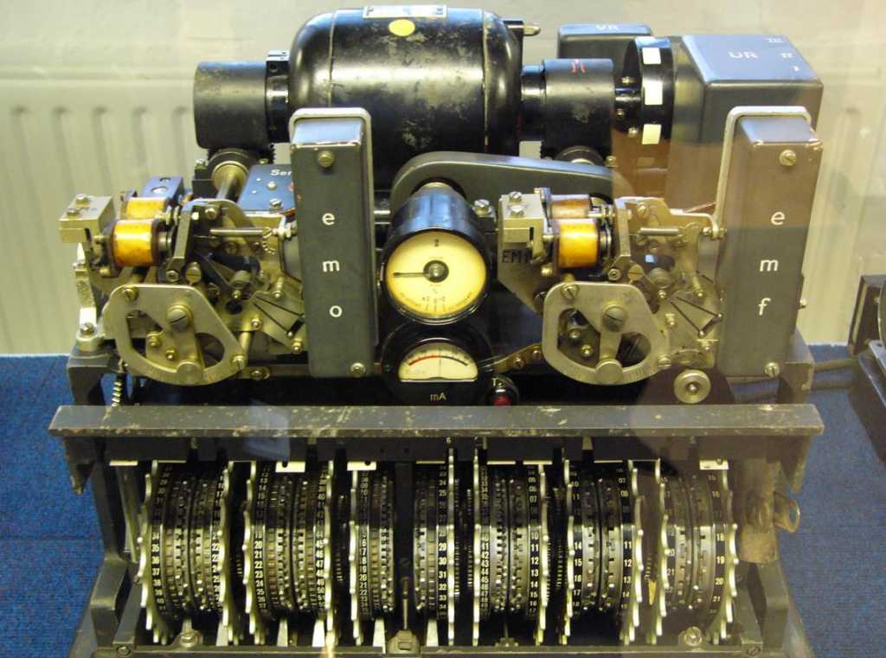
Lorenz Cipher Machine
The Lorenz Cipher and the Postman’s Computer

Slide 53
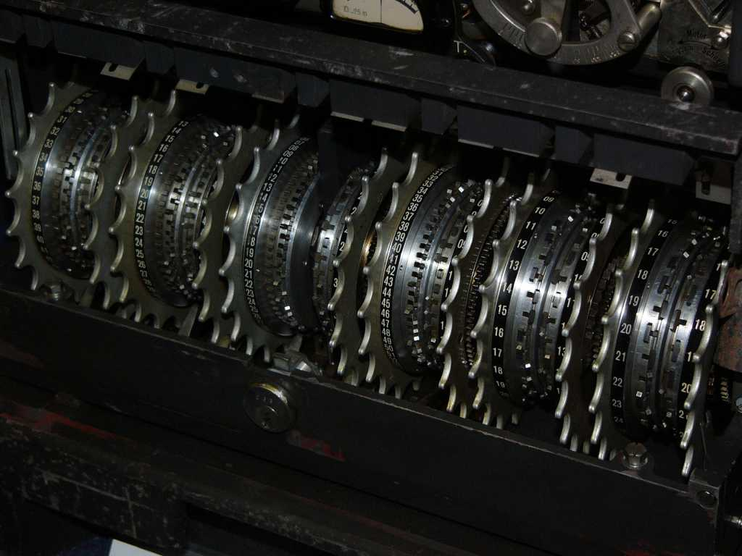
Lorenz Wheels
12 wheels
501 pins
total (set
to control wheels)
The Lorenz Cipher and the Postman’s Computer

Slide 54
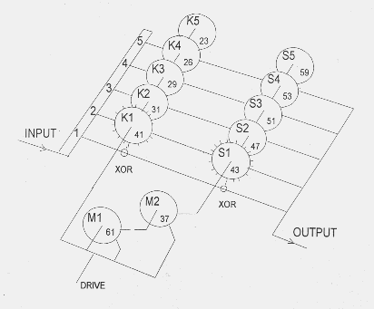
Wheel Operation
Bit
channels
(5 for Baudot)
Two XORs
with key bits
(like paper tapes)
The Lorenz Cipher and the Postman’s Computer

Slide 55
Wheel Operation
Each K wheel
rotates every letter
Each S wheel
rotates when M wheels output 1
M wheels control if S wheels rotate
The Lorenz Cipher and the Postman’s Computer

Slide 56
Use by Nazis
Considered most secure cipher machine
Messages between Hitler’s army headquarters and European capital headquarters
Each link had a slightly different system (British named them for fish):
Tunny: Vienna - Athens
Jelly: Berlin – Paris
The Lorenz Cipher and the Postman’s Computer

Slide 57
General Report on Tunny (1945, declassified in 2000)
“It is regretted that it is not possible to give an adequate idea of the fascination of a Colossus at work: its sheer bulk and apparent complexity; the fantastic speed of thin paper tape round the glittering pulleys; the childish pleasure of not-not, span, print main heading and other gadgets; the wizardry of purely mechanical decoding letter by letter (one novice thought she was being hoaxed); the periods of eager expectation culmniating in the sudden appearance of the longed-for score; the strange rhythms characterizing every type of run; the stolid rectangle interrupted by the wild leaps of the carriage-return, the frantic chatter of a motor run, the ludicrous frenzy of hosts of bogus scores.”
The Lorenz Cipher and the Postman’s Computer

Slide 58
Breaking Fish
GCHQ learned about first Fish link (Tunny) in May 1941
Intercepted unencrypted Baudot-encoded test messages
August 30, 1941: Big Break!
Operator retransmits failed message with same starting configuration
Gets lazy and uses some abbreviations, makes some mistakes
SPRUCHNUMMER/SPRUCHNR (Serial Number)
The Lorenz Cipher and the Postman’s Computer

Slide 59
“Two Time” Pad
Allies have intercepted:
C1 = M1 ⊕ K1
C2 = M2 ⊕ K1
Same key used for both (same starting configuration)
Breaking message:
C1 ⊕ C2 = (M1 ⊕ K1) ⊕ (M2 ⊕ K1)
= (M1 ⊕ M2) ⊕ (K1 ⊕ K1)
= M1 ⊕ M2
The Lorenz Cipher and the Postman’s Computer

Slide 60
“Cribs”
Know: C1, C2 (intercepted ciphertext)
C1 ⊕ C2 = M1 ⊕ M2
Don’t know M1 or M2
But, can make some guesses (cribs)
SPRUCHNUMMER
Sometimes allies moved ships, sent out bombers to help the cryptographers get good cribs
Given guess for M1, calculate M2
M2 = C1 ⊕ C2 ⊕ M1
Once guesses that work for M1 and M2
K1 = M1 ⊕ C1 = M2 ⊕ C2
The Lorenz Cipher and the Postman’s Computer

Slide 61
Finding K1
From the 2 intercepted messages, Col. John Tiltman worked on guessing cribs to find M1 and M2
4000 letter message, found 4000 letter key
Bill Tutte (recent Chemistry graduate) given task of determining machine structure from key
Already knew it was 2 sets of 5 wheels and 2 wheels of unknown function
The Lorenz Cipher and the Postman’s Computer

Slide 62
Reverse Engineering Lorenz
Looked at patterns of bits in key
Found repeating sequence:
Repetition period of 41, learned first wheel had 41 pins
Similar for other wheels, determining S/M/K wheel structure
After 6 months of hard work: determined likely machine structure that would generate K1
The Lorenz Cipher and the Postman’s Computer

Slide 63
Intercepting Traffic
Set up listening post to intercept traffic from 12 Lorenz (Fish) links
Different links between conquered capitals
Slightly different coding procedures, and different configurations
600 people worked on intercepting traffic
Sent intercepts to Bletchley (usually by motorcycle courier)
The Lorenz Cipher and the Postman’s Computer

Slide 64
Breaking Traffic
Knew machine structure, but a different initial configuration was used for each message
Need to determine wheel setting:
Initial position of each of the 12 wheels
1271 possible starting positions
Needed to try them fast enough to decrypt message while it was still strategically valuable
The Lorenz Cipher and the Postman’s Computer

Slide 65
Recognizing a Good Guess
Intercepted Message (divided into 5 channels for each Baudot code bit)
Z_{c} = z₀z₁z₂z₃z₄z₅z₆z₇…
z_{c, i} = m_{c,i} ⊕ x_{c,i} ⊕ s_{c,i}
Message Key (parts from S-wheels and rest)
Look for statistical properties
How many of the z_{c,i}’s are 0?
How many of (z_{c,i+1} ⊕ z_{c,i}) are 0?
½ (not useful)
½
The Lorenz Cipher and the Postman’s Computer

Slide 66
Double Delta
Δ Z_{c,i} = Z_{c,i} ⊕ Z_{c,i+1}
Combine two channels:
Δ Z_{1,i} ⊕ Δ Z_{2,I} =
Δ M_{1,i} ⊕ Δ M_{2,i}
⊕ Δ X_{1,i} ⊕ Δ X_{2,i}
⊕ Δ S_{1,i} ⊕ Δ S_{2,i}
> ½ Yippee!
= ½ (key)
> ½
The Lorenz Cipher and the Postman’s Computer

Slide 67
Double Delta
Δ M_{1,i} ⊕ Δ M_{2,i}
⊕ Δ X_{1,i} ⊕ Δ X_{2,i}
⊕ Δ S_{1,i} ⊕ Δ S_{2,i}
> ½ Yippee!
= ½ (key)
> ½
Why is Δ M_{1,i} ⊕ Δ M_{2,i} > ½
Message is in German, more likely following letter is a repetition than random
Why is Δ S_{1,i} ⊕ Δ S_{2,i} > ½
S-wheels only turn some of the time
(when M-wheel is 1)
The Lorenz Cipher and the Postman’s Computer

Slide 68
Actual Advantage
Probability of repeating letters
Prob[Δ M_{1,i} ⊕ Δ M_{2,i} = 0] ~ 0.614 3.3% of German digraphs are repeating
Probability of repeating S-keys
Prob[Δ S_{1,i} ⊕ Δ S_{2,i} = 0] ~ 0.73
Prob[Δ Z_{1,i} ⊕ Δ Z_{2,I} ⊕ Δ X_{1,i} ⊕ Δ X_{2,i} = 0]
= 0.614 * 0.73 + (1-0.614) * (1-0.73)
Δ M and S are 0 Δ M and S are 1
= 0.55
The Lorenz Cipher and the Postman’s Computer

Slide 69
Using the Advantage
If the guess of X is correct, should see higher than ½ of the double deltas are 0
Try guessing different configurations to find highest number of 0 double deltas
Problem:
# of double delta operations to try one config
= length of Z * length of X
= for 10,000 letter message = 12 M for each setting * 7 ⊕ per double delta
= 89 M ⊕ operations
The Lorenz Cipher and the Postman’s Computer

Slide 70
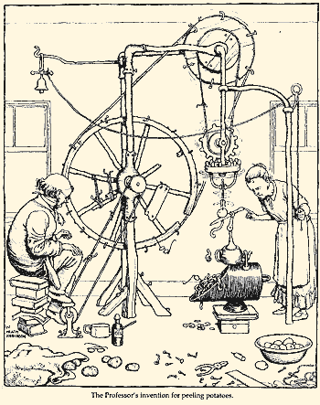
Heath Robinson
Dec 1942: Decide to build a machine to do these ⊕s quickly, due June 1943
Apr 1943: first Heath Robinson machine is delivered!
Intercepted ciphertext on tape:
2000 characters per second (12 miles per hour)
Needed to perform 7 ⊕ operations each ½ ms
Heath Robinson, British Cartoonist (1872-1944)
The Lorenz Cipher and the Postman’s Computer

Slide 71
Colossus
Heath Robinson machines were too slow
Colossus designed and first built in Jan 1944
Replaced keytext tape loop with electronic keytext generator
Speed up ciphertext tape:
5,000 chars per second = 30 mph
Perform 5 double deltas simultaneously
Speedup = 2.5X for faster tape * 5X for parallelism
The Lorenz Cipher and the Postman’s Computer

Slide 72
Colossus Design
Ciphertext Tape
Electronic Keytext Generator
Logic
Tape Reader
Counter
Position Counter
Printer
The Lorenz Cipher and the Postman’s Computer

Slide 73
Impact on WWII
10 Colossus machines operated at Bletchley park
Various improvements in speed
Decoded 63 million letters in Nazi command messages
Learned German troop locations to plan D-Day (knew the deception was working)
The Lorenz Cipher and the Postman’s Computer

Slide 74
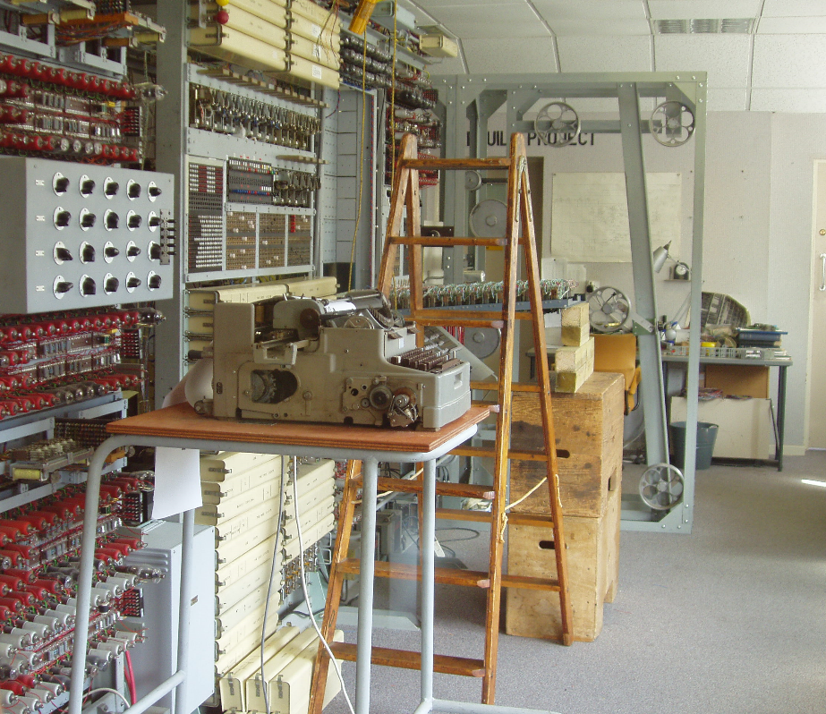
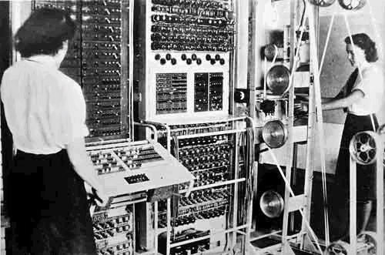
Colossus History
Kept secret after the war, all machines destroyed
During WWII
Rebuild, Bletchley Park,
Summer 2004
The Lorenz Cipher and the Postman’s Computer

Slide 75
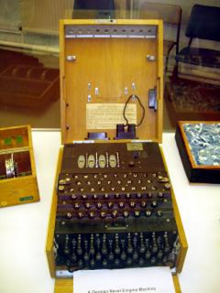
Enigma
Invented commercially, 1923
Used by German Navy, Army, Air Force
About 50,000 in use
Modified throughout WWII, believed to be perfectly secure
Kahn’s Codebreakers (1967) didn’t know it was broken
Turing’s 1940 Treatise on Enigma declassified in 1996
Enigma machine at Bletchley Park
Captain Ridley’s Shooting Party

Slide 76
Simple Substitution Ciphers (from Class 1)
ABCDEFGHIJKLMNOPQRSTUVWXYZ
encrypt
decrypt
JIDKQACRSHLGWNFEXUZVTPMYOB
JILL ⇒ HSGG
Captain Ridley’s Shooting Party

Slide 77
Rotating Substitution Cipher
ABCDEFGHIJKLMNOPQRSTUVWXYZ
encrypt
JIDKQACRSHLGWNFEXUZVTPMYOBJID
JIDKQACRSHLGWNFEXUZVTPMYOBJI
JIDKQACRSHLGWNFEXUZVTPMYOBJ
JIDKQACRSHLGWNFEXUZVTPMYOB
J ⇒ H
I ⇒ H
L ⇒ N
L ⇒ F
JILL ⇒ HHNF
Captain Ridley’s Shooting Party

Slide 78
Rotating Substitution Cipher
Rotates the mapping every letter
Hides simple statistical properties of plaintext:
Frequency analysis defeated: E encrypts to different letters
Repeated letter will not encrypt the same way in different positions
Captain Ridley’s Shooting Party

Slide 79
Rotating Substitution Weaknesses
Will repeat after 26 letters
If there is a lot of ciphertext, can still do frequency analysis on every 26th letter slides
Some properties revealed
If we see repeated letters in ciphertext, what does it mean?
JILL ⇒ HHNF
Captain Ridley’s Shooting Party

Slide 80
Multiple Substitution Ciphers
ABCDEFGHIJKLMNOPQRSTUVWXYZ
This doesn’t help at all: Any number
of multiple simple substitutions
can be replaced
by one substitution!
JIDKQACRSHLGWNFEXUZVTPMYOB
ABCDEFGHIJKLMNOPQRSTUVWXYZ
SQHLZNYKXUWVJRDFBETIMOGACP
J ⇒ K
Captain Ridley’s Shooting Party

Slide 81
Multiple Rotating Substitutions
ABCDEFGHIJKLMNOPQRSTUVWXYZ
Now it only repeats when both wheels have cycled: 26*26 = 676 letters!
Wheel 1: Rotate one position every letter
JIDKQACRSHLGWNFEXUZVTPMYOB
ABCDEFGHIJKLMNOPQRSTUVWXYZ
Wheel 2: Rotate one position every 26 letters
SQHLZNYKXUWVJRDFBETIMOGACP
Captain Ridley’s Shooting Party

Slide 82
Multiple Rotating Substitutions
ABCDEFGHIJKLMNOPQRSTUVWXYZ
Wheel 1: Rotate one position every letter
Now it only repeats when all 3 wheels have cycled:
26*26 * 26
= 17576 letters!
JIDKQACRSHLGWNFEXUZVTPMYOB
ABCDEFGHIJKLMNOPQRSTUVWXYZ
Wheel 2: Rotate one position every 26 letters
SQHLZNYKXUWVJRDFBETIMOGACP
ABCDEFGHIJKLMNOPQRSTUVWXYZ
Wheel 3: Rotate one position when wheel 2 cycles
UAVGRDCBESYHLZOQKXTIMNJWFP
Captain Ridley’s Shooting Party

Slide 83
Enigma
Captain Ridley’s Shooting Party

Slide 84
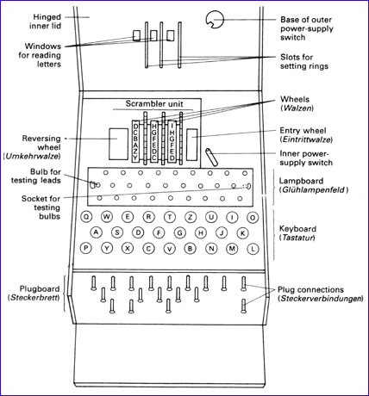
Enigma Mechanics
Three rotors (chosen from 5), scrambled letters
Each new letter, first rotor advances
Other rotors advance when ring is hit
Reflector
Plugboard
Captain Ridley’s Shooting Party

Slide 85
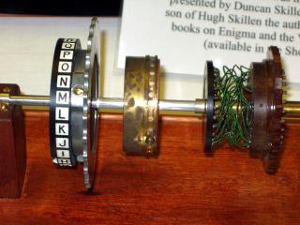
Rotor Wheel
Simple
substitution
No letter maps to itself
Latch turns next rotor once per rotation
Captain Ridley’s Shooting Party

Slide 86
Settings
Plugboard: swap pairs of letters
Number of plugs varied (≤ 6 until 1939, up to 10 after)
Rotors
Before 1939 – Three rotors (choose order)
After – Choose 3 from set of 5 rotors
Orientations (3) – start orientations of the 3 rotors
Ring settings (2) – when next ring advances
Reflector
Fixed symmetric substitution (A→B ⇒ B→ A)
Involution: if we do it twice, get original back
Captain Ridley’s Shooting Party

Slide 87
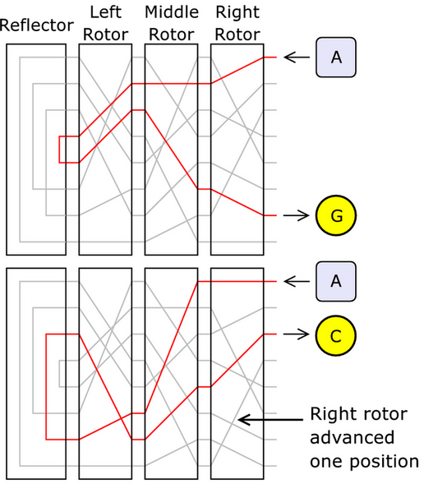
Image from
http://en.wikipedia.org/wiki/Image:Enigma-action.png
Captain Ridley’s Shooting Party

Slide 88
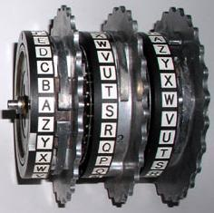
Three Rotor Wheels
Captain Ridley’s Shooting Party

Slide 89
Enigma Schematic
Turns every letter
B
Plugboard
L
Rotor
1
M
Rotor
2
N
Rotor
3
R
Reflector
Plaintext
Ciphertext
Ciphertext = B⁻¹L⁻¹M⁻¹N⁻¹RNMLB(Plaintext)
Captain Ridley’s Shooting Party

Slide 90
Does Decryption Work?
B
Plugboard
L
Rotor
1
M
Rotor
2
N
Rotor
3
R
Reflector
Plaintext
Ciphertext
C = B⁻¹L⁻¹M⁻¹N⁻¹RNMLB(P)
P = B⁻¹L⁻¹M⁻¹N⁻¹RNMLB(C)
= B⁻¹L⁻¹M⁻¹N⁻¹RNMLB(B⁻¹L⁻¹M⁻¹N⁻¹RNMLB(P))
R is an involution
(A→B ⇒ B→ A)
Captain Ridley’s Shooting Party

Slide 91
Key Space
Plugboard with 6 plugs:
(26 * 25/2) * … * (16*15 / 2) / 6! ≈ 10¹¹
B
Plugboard
L
Rotor
1
M
Rotor
2
N
Rotor
3
R
Reflector
Plaintext
Rotors: (26!)³ ≈ 4 * 10²⁶
Ring settings: 26² = 676
Message Key: 26³ = 17576
Ciphertext
Reflector:
(26 * 25 / 2) * (24 * 23 / 2)
* … * (2 * 2) / 13! ≈ 8 * 10¹²
Total: ≈ 6 * 10¹¹⁰ (not all are different)
>> 10⁸⁴ atoms in the universe
Captain Ridley’s Shooting Party

Slide 92
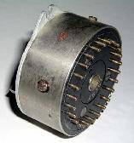
Reducing Key Space
Plugboard with 6 plugs ≈ 10¹¹
Rotors: (26!)³ ≈ 4 * 10²⁶
Ring settings: 26² = 676
Message Key: 26³ = 17576
Reflector: ≈ 8 * 10¹²
Captain Ridley’s Shooting Party

Slide 93
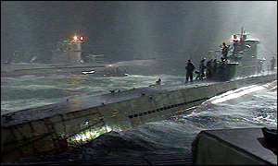
Capture a Machine
“This fictional movie about a fictional U.S. submarine mission is followed by a mention in the end credits of those actual British missions. Oh, the British deciphered the Enigma code, too. Come to think of it, they pretty much did everything in real life that the Americans do in this movie.”
Roger Ebert’s review of U-571
Captain Ridley’s Shooting Party

Slide 94
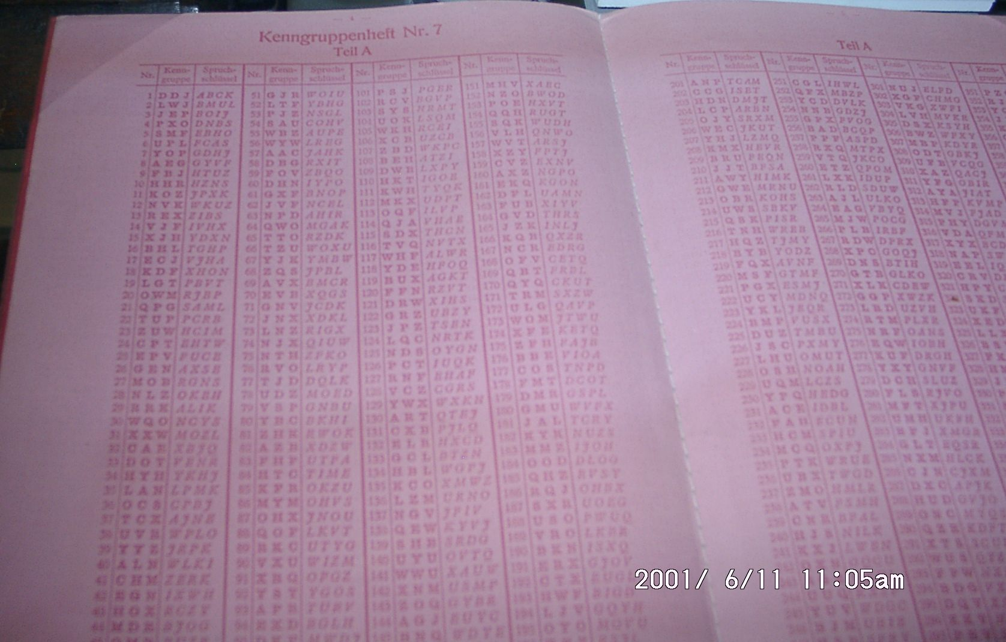
Codebook (Rotor Settings)
Captured from a U-Boat
Captain Ridley’s Shooting Party

Slide 95
Key Space
B
Plugboard
Plaintext
Ciphertext
L
Rotor
1
Plugboard with 6 plugs:
(26 * 25/2) * … * (16*15 / 2) / 6! ≈ 10¹¹
M
Rotor
2
Rotors: (26!)³ ≈ 4 * 10²⁶
Ring settings: 26² = 676
Message Key: 26³ = 17576
5 C 3 = 60
N
Rotor
3
R
Reflector
Reflector:
(26 * 25 / 2) * (24 * 23 / 2)
* … * (2 * 2) / 13! ≈ 8 * 10¹²
1
Total: ≈ 7 * 10¹⁹
(> 2⁶⁴, still too big for exhaustive search)
Captain Ridley’s Shooting Party

Slide 96
Plugless Enigma
L
Rotor
1
M
Rotor
2
N
Rotor
3
R
Reflector
Plaintext
Ciphertext
C = L⁻¹M⁻¹N⁻¹RNML(P)
Used in Spanish Civil War (1937-9) by all participants
(including British, Germans and Spanish)
Captain Ridley’s Shooting Party

Slide 97
Plugless Enigma
L
Rotor
1
M
Rotor
2
N
Rotor
3
R
Reflector
Plaintext
Z
Ciphertext
Probable words (4-10 letters)
What is the probability that Rotor 2
and Rotor 3 do not move in 4 letter crib?
C = L⁻¹ZL(P)
L(C) = ZL(P)
= 22/26 = .85
Captain Ridley’s Shooting Party

Slide 98
Plugless Enigma
L
Rotor
1
M
Rotor
2
N
Rotor
3
R
Reflector
Plaintext
C = L⁻¹ZL(P)
L(C) = ZL (P)
Z
Ciphertext
Z is a fixed substitution (monoalphabetic) if R2&3 don’t move
Guess a crib – have C and P_{guess}
L(C) = ZL(P_{guess})
Try possible rotors and starting positions for L:
3 rotor choices * 26 starting positions = 78
L_{i} = effect of Rotor 1 in the i^{th} rotation position
Captain Ridley’s Shooting Party

Slide 99
Batons Attack
C = XTSWVUINZ
P_{guess} = wehrmacht (“armed forces”)
L₁ (X) = Z L₁ (w)
L₂ (T) = Z L₂ (e)
L₃ (S) = Z L₃ (h)
L₄ (W) = Z L₄ (r)
L₅ (V) = Z L₅ (m)
L₆ (U) = Z L₆ (a)
L₇ (I) = Z L₇ (c)
ABCDEFGHIJKLMNOPQRSTUVWXYZ
EKMFLGDQVZNTOWYHXUSPAIBRCJ
JEKMFLGDQVZNTOWYHXUSPAIBRC
CJEKMFLGDQVZNTOWYHXUSPAIBR
RCJEKMFLGDQVZNTOWYHXUSPAIB
BRCJEKMFLGDQVZNTOWYHXUSPAI
IBRCJEKMFLGDQVZNTOWYHXUSPA
AIBRCJEKMFLGDQVZNTOWYHXUSP
For a given starting rotor setting, solve for Z
1: R = Z(B) 2: S = Z(F) 3: X = Z(G) 4: P = Z(Y)
5: U = Z(V) 6: H = Z(I) 7: M = Z(B)
Captain Ridley’s Shooting Party

Slide 100
Batons Attack
We know Z is:
Function: contradiction if Z(x) ≠ Z(x)
Involution: contradiction if Z(x) = y & Z(y) ≠ x
Find a rotor setting with no contradictions
Long enough crib, there will only be one
But if crib is too long, need to deal with R2 moving
List of probable 4-10 letter words
Catalog to map Z to rotor settings for R2 and R3
Captain Ridley’s Shooting Party

Slide 101
Plugless Enigma
L
Rotor
1
M
Rotor
2
N
Rotor
3
R
Reflector
Plaintext
Ciphertext
Ideas for making Batons attack harder?
Captain Ridley’s Shooting Party

Slide 102
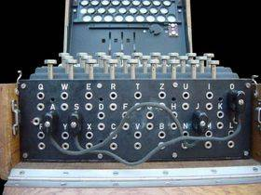
Enter the Plugboard
B
Plugboard
L
Rotor
1
M
Rotor
2
N
Rotor
3
R
Reflector
Plaintext
Ciphertext
6 plugs: (26*25)/2 * (24*23)/2 * …
* (16*15/2) / 6!
~ 10¹¹ times more keys
Captain Ridley’s Shooting Party
Notes:
Step rotor 2 faster – British and US experimented with this
Change order of rotors – fastest turning rotor closest to reflector

Slide 103
Operation
Day key (distributed in code book)
Each message begins with message key (“randomly” chosen by sender) encoded using day key
Message key sent twice to check
After receiving message key, re-orient rotors according to key
Captain Ridley’s Shooting Party

Slide 104
Codebook Zoom
Captain Ridley’s Shooting Party

Slide 105
Repeated Message Key
P = P₁P₂P₃P₁P₂P₃
C₁ = E₁ (P₁) = B⁻¹L₁⁻¹M⁻¹N⁻¹RNML₁B(P₁)
C₄ = E₄ (P₁) =B⁻¹L₄⁻¹M⁻¹N⁻¹RNML₄B(P₁)
P₁ = E₁ (C₁) = B⁻¹L₁⁻¹M⁻¹N⁻¹RNML₁B(C₁)
P₁ = E₄ (C₄) = B⁻¹L₄⁻¹M⁻¹N⁻¹RNML₄B(C₄)
E₄oE₁ (C₁) = E₄ (P₁) = C₄
E₄oE₁ = B⁻¹L₁⁻¹M⁻¹N⁻¹RNML₁B B⁻¹L₄⁻¹M⁻¹N⁻¹RNML₄B
= B⁻¹L₁⁻¹M⁻¹N⁻¹RNML₁L₄⁻¹M⁻¹N⁻¹RNML₄B
Captain Ridley’s Shooting Party

Slide 106
Letter Permutations
Symmetry of Enigma:
if E_{pos} (x) = y we know E_{pos} (y) = x
Given message openings
DMQ VBM E₁(m₁) = D E₄(m₁) = V E₁oE₄(D) = V
VON PUY => E₁(D) = m₁
PUC FMQ => E₄ (E₁ (D)) = V
With enough message openings, we can build complete cycles for each position pair:
E₁oE₄ = (DVPFKXGZYO) (EIJMUNQLHT) (BC) (RW) (A) (S)
Note: Cycles must come in pairs of equal length
Captain Ridley’s Shooting Party

Slide 107
Composing Involutions
E₁ and E₂ are involutions (x → y ⇒ y → x)
Without loss of generality, we can write:
E₁ contains (a₁a₂) (a₃a₄) … (a_{2k-1}a_{2k})
E₂ contains (a₂a₃) (a₄a₅) … (a_{2k}a₁)
E₁ E₂
a₁ ↔ a₂ a₂ ↔ x = a₃ or x = a₁
a₃ ↔ a₄ a₄ ↔ x = a₅ or x = a₁
Why can’t x be a₂ or a₃?
Captain Ridley’s Shooting Party

Slide 108
Rejewski’s Theorem
E₁ contains (a₁a₂) (a₃a₄) … (a_{2k-1}a_{2k})
E₄ contains (a₂a₃) (a₄a₅) … (a_{2k}a₁)
E₁E₄ contains (a₁a₃a₅…a_{2k-1})
(a_{2k}a_{2k-2}… a₄a₂)
The composition of two involutions consists of pairs of cycles of the same length
For cycles of length n, there are n possible factorizations
Captain Ridley’s Shooting Party

Slide 109
Factoring Permutations
E₁E₄ = (DVPFKXGZYO) (EIJMUNQLHT) (BC) (RW) (A) (S)
(A) (S) = (AS) o (SA)
(BC) (RW) = (BR)(CW) o (BW)(CR)
or = (BW)(RC) o (WC) (BR)
(DVPFKXGZYO) (EIJMUNQLHT)
= (DE)(VI)… or (DI)(VJ) … or (DJ)(VM) …
… (DT)(VE) 10 possibilities
Captain Ridley’s Shooting Party

Slide 110
How many factorizations?
(DVPFKXGZYO) (EIJMUNQLHT)
E₁
E₂
D ↔ a₂
a₂ ↔ V
V ↔ a₄
a₄ ↔ P
Once we guess a₂ everything else must follow!
So, only n possible factorizations for an n-letter cycle
Total to try = 2 * 10 = 20
E₂E₅ and E₃E₆ likely to have about 20 to try also
About 20³ (8000) factorizations to try
(still too many in pre-computer days)
Captain Ridley’s Shooting Party

Slide 111
Luckily…
Operators picked message keys (“cillies”)
Identical letters
Easy to type (e.g., QWE)
If we can guess P₁ = P₂ = P₃ (or known relationships) can reduce number of possible factorizations
If we’re lucky – this leads to E₁ …E₆
Captain Ridley’s Shooting Party

Slide 112
Solving?
E₁ = B⁻¹L⁻¹Q LB
E₂ = B⁻¹L⁻²QL²B
E₃ = B⁻¹L⁻³QL³B
E₄ = B⁻¹L⁻⁴QL⁴B
E₅ = B⁻¹L⁻⁵QL⁵B
E₆ = B⁻¹L⁻⁶QL⁶B
6 equations, 3 unknowns
Not known to be efficiently solvable
Captain Ridley’s Shooting Party

Slide 113
Solving?
E₁ = B⁻¹L⁻¹Q LB
BE₁B⁻¹ = L⁻¹Q L
6 equations, 2 unknowns – solvable
Often, know plugboard settings (didn’t change frequently)
6 possible arrangements of 3 rotors, 26³ starting locations
= 105,456 possibilities
Poles spent a year building a catalog of cycle structures
covering all of them (until Nov 1937): 20 mins to break
Then Germans changed reflector and they had to start over.
Captain Ridley’s Shooting Party

Slide 114
1939
Early 1939 – Germany changes scamblers and adds extra plugboard cables, stop double-transmissions
Poland unable to cryptanalyze
25 July 1939 – Rejewski invites French and British cryptographers
Gives England replica Enigma machine constructed from plans, cryptanalysis
1 Sept 1939 – Germany invades Poland, WWII starts
Captain Ridley’s Shooting Party

Slide 115
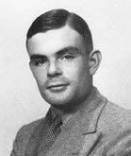
Alan Turing
Leads British effort to crack Enigma
Use cribs (“WETTER” transmitted every day at 6am) to find structure of plugboard settings
10,000 people worked at Bletchley Park on breaking Enigma (100,000 for Manhattan Project)
Captain Ridley’s Shooting Party

Slide 116
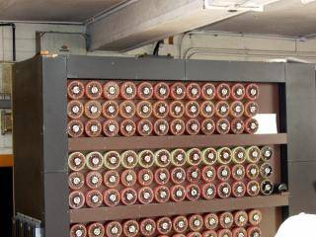
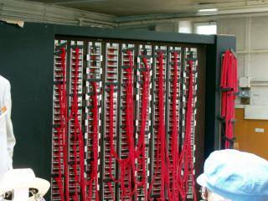
Alan Turing’s “Bombe”
Steps through all possible rotor positions (26³), testing for probable plaintext; couldn’t search all plugboard settings (> 10¹²); take advantage of loops in cribs
Captain Ridley’s Shooting Party

Slide 117
“Bombes”
Idea by Alan Turing
Name from Rejewski’s “Bomba” machine (Polish for bomb)
“for lack of a better idea” (Rejewki’s paper)
Design by “Doc” Keen, British Tabulating Machine Co.
First machine, “Victory”: Bletchley Park, March 1940
Captain Ridley’s Shooting Party

Slide 118
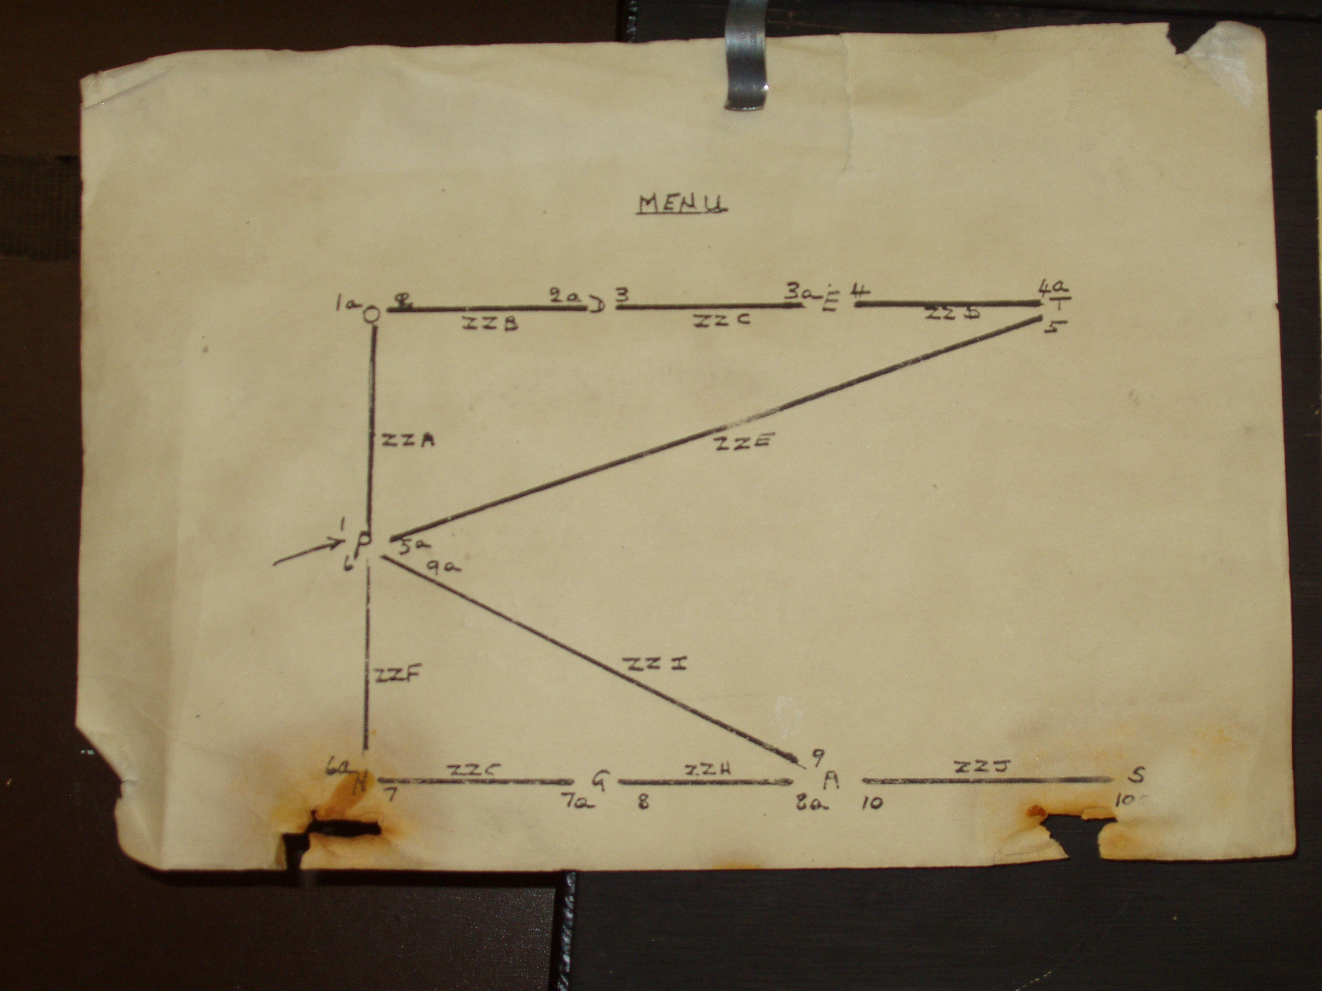
Captain Ridley’s Shooting Party

Slide 119
Enigma Cryptanalysis
Relied on combination of sheer brilliance, mathematics, espionage, operator errors, and hard work
Huge impact on WWII
Britain knew where German U-boats were
Advance notice of bombing raids
But...keeping code break secret more important than short-term uses or giving credit: Turing’s Enigma report declassified in 1996!
Captain Ridley’s Shooting Party

Slide 120
Turing after the War
Made several major contributions to Computer Science (both before and after)
Most important award is named “Turing Award”
Prosecuted for homosexuality
Illegal in Britain
Forced hormone treatment
1954 – died of cyanide poisoning from eating apple (believed to be suicide)
Captain Ridley’s Shooting Party

Slide 121

Thanks and any questions?
Cryptography before World War II
The materials of this lecture are mostly from Washington university

